Slide 1
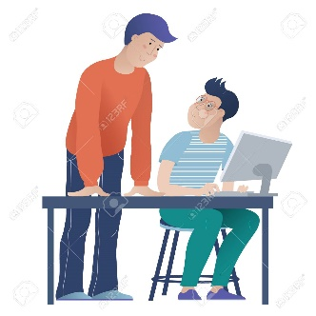


Assistive Technology(AT) For
Students with Disabilities
To Use At Home
  Adam Krass, MS, ATP
  President
  Adam Krass Consulting, LLC
  Grant Partner: SPAN Parent Advocacy Network
  Funded Through
  The AT For Students with Disabilities and Their Families 2019-2020 Project
  Disability Rights New Jersey/Assistive Technology Advocacy Center

Slide 2

AT For Students with Disabilities
To Use At Home
What Is Assistive Technology (AT)?
Assistive technology is any item, piece of equipment, or product system, whether acquired commercially off the shelf, modified, or customized, that is used to increase, maintain, or improve the functional capabilities of a child with a disability. The term does not include a medical device that is surgically implanted, or the replacement of such device.
Based on IDEA, Sec. 300.5 Assistive technology device.

Slide 3
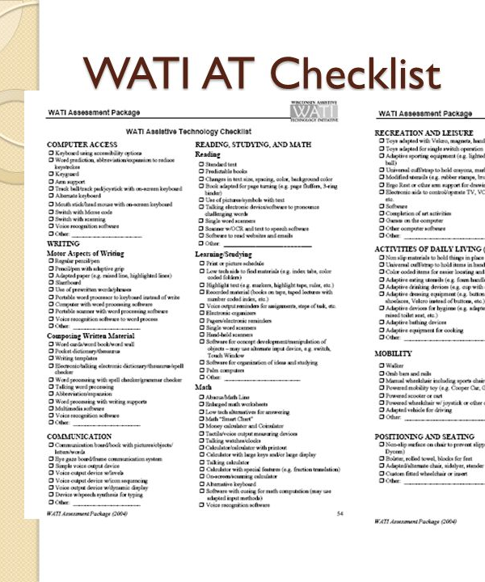
AT For Students with Disabilities
To Use At Home
The AT Checklist
  Created by WATI (Wisconsin Assistive Technology Initiative)
  A great tool for IEP meetings and conducting AT Considerations
  Uses generic examples of AT
  Lists are organized from low- to high-tech

Slide 4
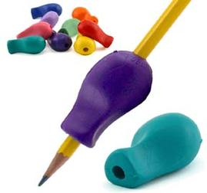
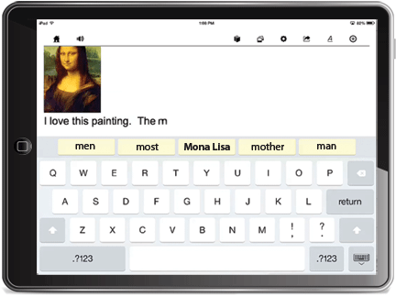
AT For Students with Disabilities
To Use At Home:
Writing
Adapted pencils or grips
DIY Slant Board (Three-Ring Binder and Tape)
Keyboarding via a computer, Chromebook, tablet, or smart phone
Google Docs with Voice Typing
Read and Write for Google

Slide 5
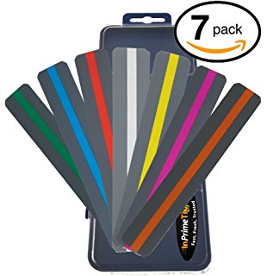
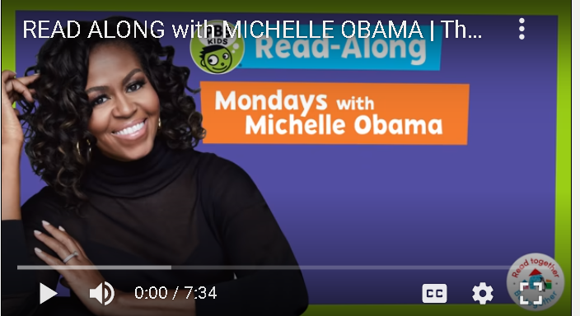
AT For Students with Disabilities
To Use At Home:
Reading
DIY Reading guides
Digital audiobooks from your local library (Hoopla, Overdrive, Libby)
Storyline Online
Tar Heel Reader
Starfall.com
Reading Rockets
PBS Kids (Michelle Obama)
NewsELA
Read and Write for Google

Slide 6
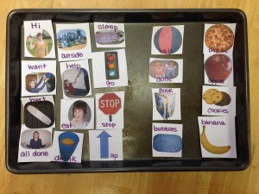
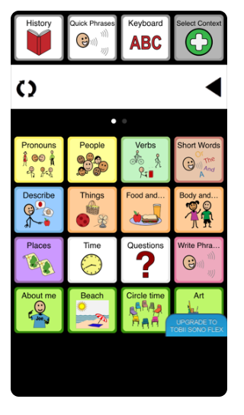
AT For Students with Disabilities
To Use At Home:
Communication
DIY Paper communication boards and books
Low-cost single message devices
Free Communication Apps
  SonoFlex Lite (iOS)
  Avaz (iOS or Android)

Slide 7
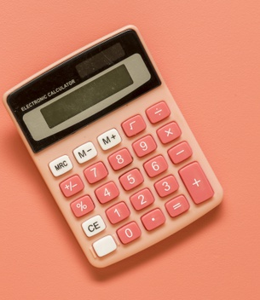
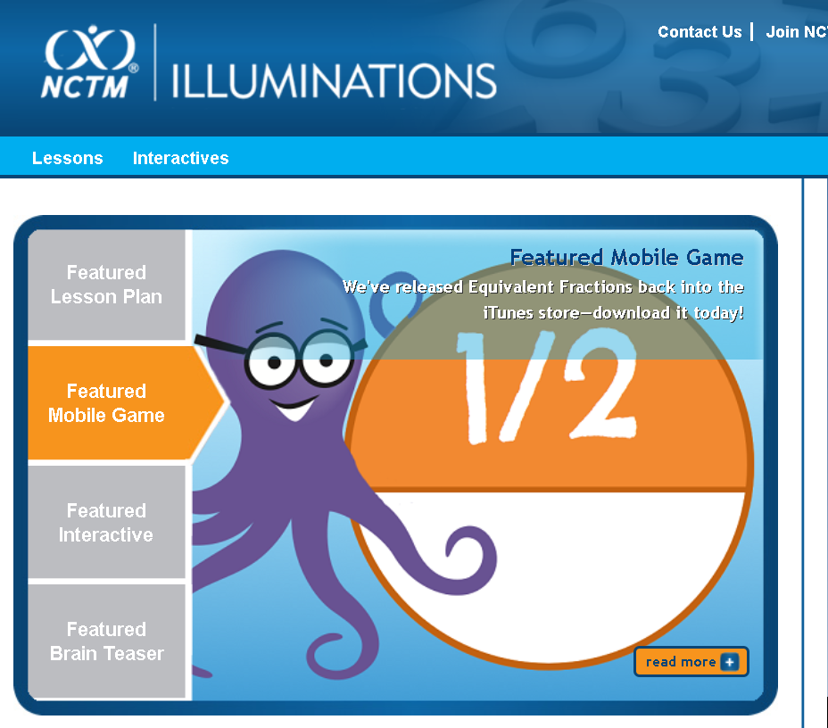
AT For Students with Disabilities
To Use At Home:
Math
Calculators
Illuminations (virtual manipulatives/visualization)
Digital math workspace apps
  iOS, Android
iXL website

Slide 8
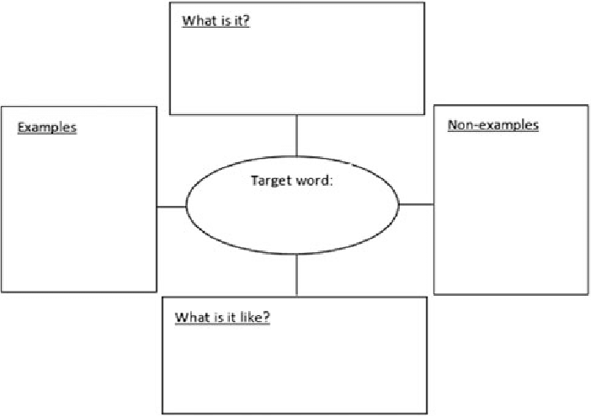

AT For Students with Disabilities
To Use At Home:
Organizational Skills
To-Do Lists
Graphic organizers
  Printable Templates
  Graphic Organizer Programs
    MindMup
    Bubbl

Slide 9
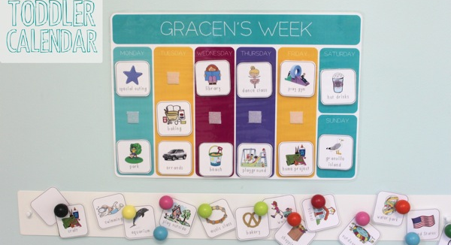
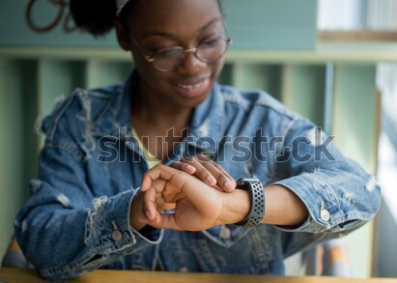
AT For Students with Disabilities
To Use At Home:
Time Management and Scheduling
DIY Picture Schedules
Visual timers (kitchen timer, smartphone)
Google Calendar (with reminders)

Slide 10

AT For Students with Disabilities
To Use At Home
Please Complete A Short Survey For This Presentation. Thank you!
Here is the link to the ATAC Device Demonstration Survey:
https://forms.gle/V8BdPQSxvm8wKDfTA

Slide 11

AT For Students with Disabilities
To Use At Home
Thank You!
For Questions or More Information
  Adam Krass, MS, ATP
  Adam Krass Consulting, LLC
  Phone: 201-618-2315
  Email: adam@adamkrassconsulting.com
  Website: www.adamkrassconsulting.com
  Twitter: @adamkrassAT

